Slide 1
Tìm hiểu Matlab Simscape Multibody và ứng dụng trong mô phỏng hệ thống lái EPS

Slide 2
Plan
Week 1 : Introduction
Week 2 : Theoretical basis of EPS system and build the basic model for this system
Week 3 : Build mechanical model of steering system on Simulink.
Week 4 : Build a functional block to get the necessary output of the system
Week 5 : Build Controller for motor
Week 6: Continue building controller and try to combine with the rest of system
Week 7: Complete whole system and show the result from simulation
Week 8: Review, (finish outline, poster) and complete the project’s report
Now we are at week 3.

Slide 3
What we have done so far
Build 3D model on Solidwork
1
Export to Simulink (Simscape Multibody) to make it run correctly
2
Note down theorical basis of Steering system (input and output)
3

Slide 4
What we have not figured out in time:
Get the signal from pinion inside Simulink model
1
Find a solution to replace torsion bar in Simulink
2
Execute the input to Simscape Multibody model (not Simulink)
3
Have some difficulty in learning block’s functions.
4

Slide 5
Ability to meet progress in time
Highly running out of time to build motor for EPS system
-> Find some sample model and learn from them to reduce time consuming
Medium alert with figuring out how to use block’s functions (there are very new block so no tutorial available at the moment)

Slide 6
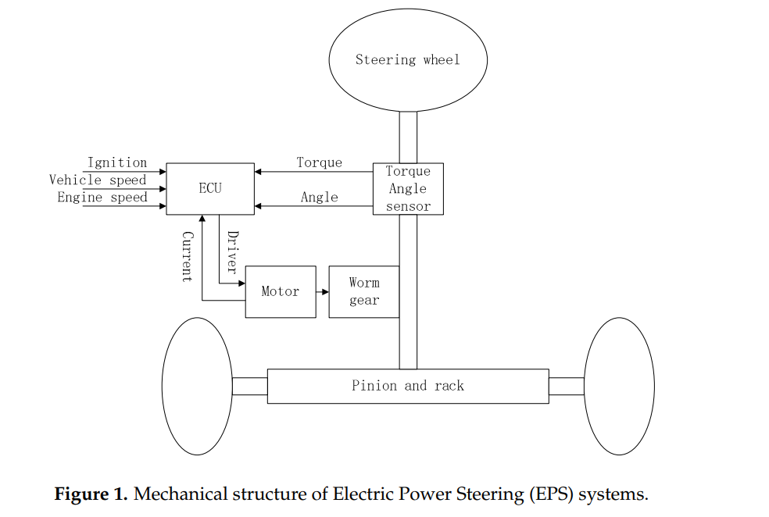
General schematic of EPS

Slide 7
Simscape demo

